Slide 1
Welcome to the experiment ☺
The experiment will take approximately 1h30min – 2h, and it’s split into 3 main sessions
The tasks are the same, but stimuli slightly differ
Before each session starts, you will go through the specific instructions
Here is the general instruction

Slide 2


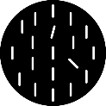

Ex)
In each frame, 3 disks and a red fixation dot will be presented
In each trial, in the second and the last frame, multiple bars will be presented in the disks
Only one of these 3 disks is the target disk, and it differs in each session, you will have the specific instruction before the session. Left figure is an example
cue frame
The second frame is called cue frame, and the last frame is called probe frame
In the target disk of the cue frame, there will be two tilted bars, one in 15◦ (target) and the other in 45◦(distractor)
In the target disk of the probe frame, one bar will be tilted in 15◦(target)
Bars can be tilted either clockwise or counter-clockwise compared to the vertical
Your task is to detect whether the target bars (15◦ tilted bars) in cue and probe frames are tilted in the same direction or not
You have to ignore the 45◦(distractor) bar in the cue frame
If both are tilted in a same direction (both clockwise and counter-clockwise) press the left button, otherwise the right button if they are in different directions
probe frame
t
Continue …

Slide 3
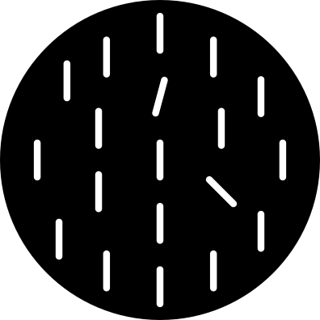
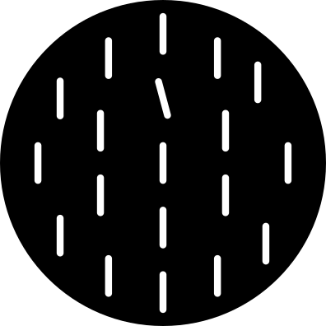
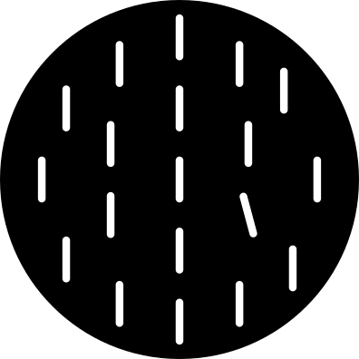
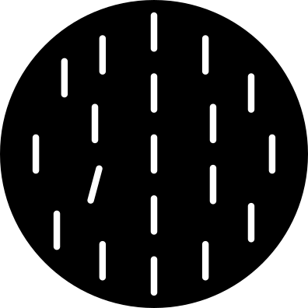
There are three possible positions for the tilted bars (red circles)
In the cue frame, the target bar (15◦) and the distractor bar (45◦) are presented in two different positions
In the probe frame, the target bar (15◦) can be presented in any of the three positions, therefore, it may be in the same position as cue-target position, the cue-distractor position, or the third position
ex. Cue frame and Probe frames
The target positions are not important. Your task is to detect whether target bars in cue and probe frames are tilted in a same direction or not
If both are tilted in a same direction (both clockwise and counter-clockwise) press the left button, otherwise the right button if they are in different directions
Cue frame
Target →
← distractor
Probe frame
Cue frame
Probe frame
Cue frame
Probe frame
Target →
or
or
Target →
← Target
Same position as cue-target
Same position as cue-distractor
The third position
Same direction: left button (arrow)
Different direction: right button (arrow)

Slide 4
Thanks a lot for your participation! ☺

